Slide 1
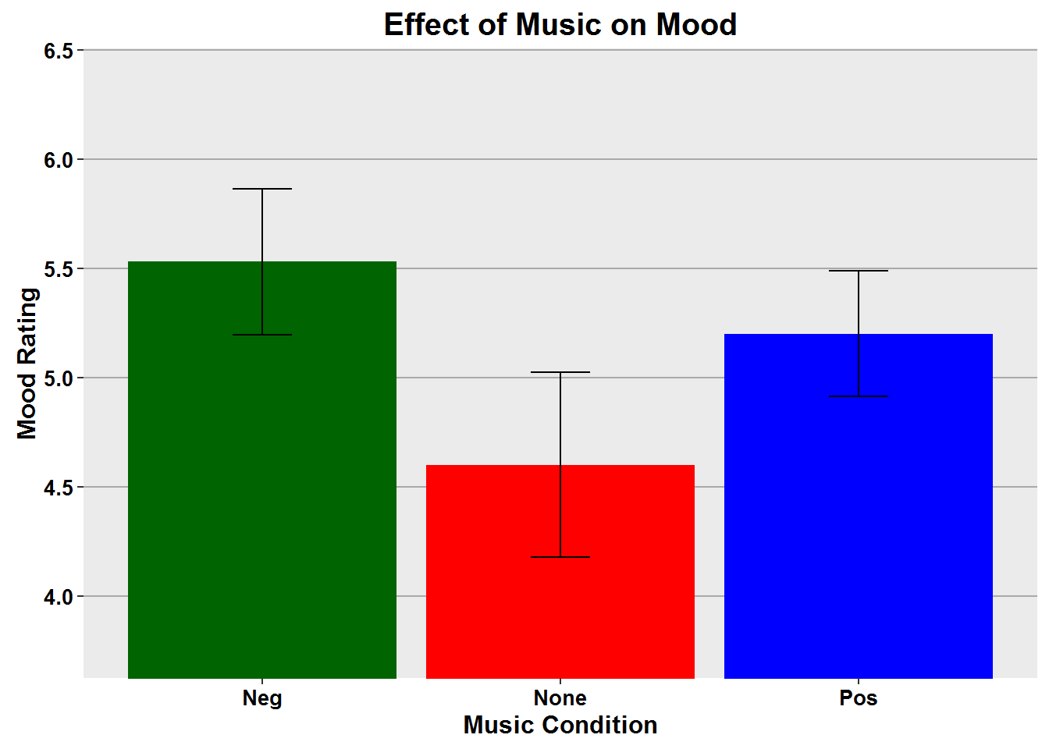
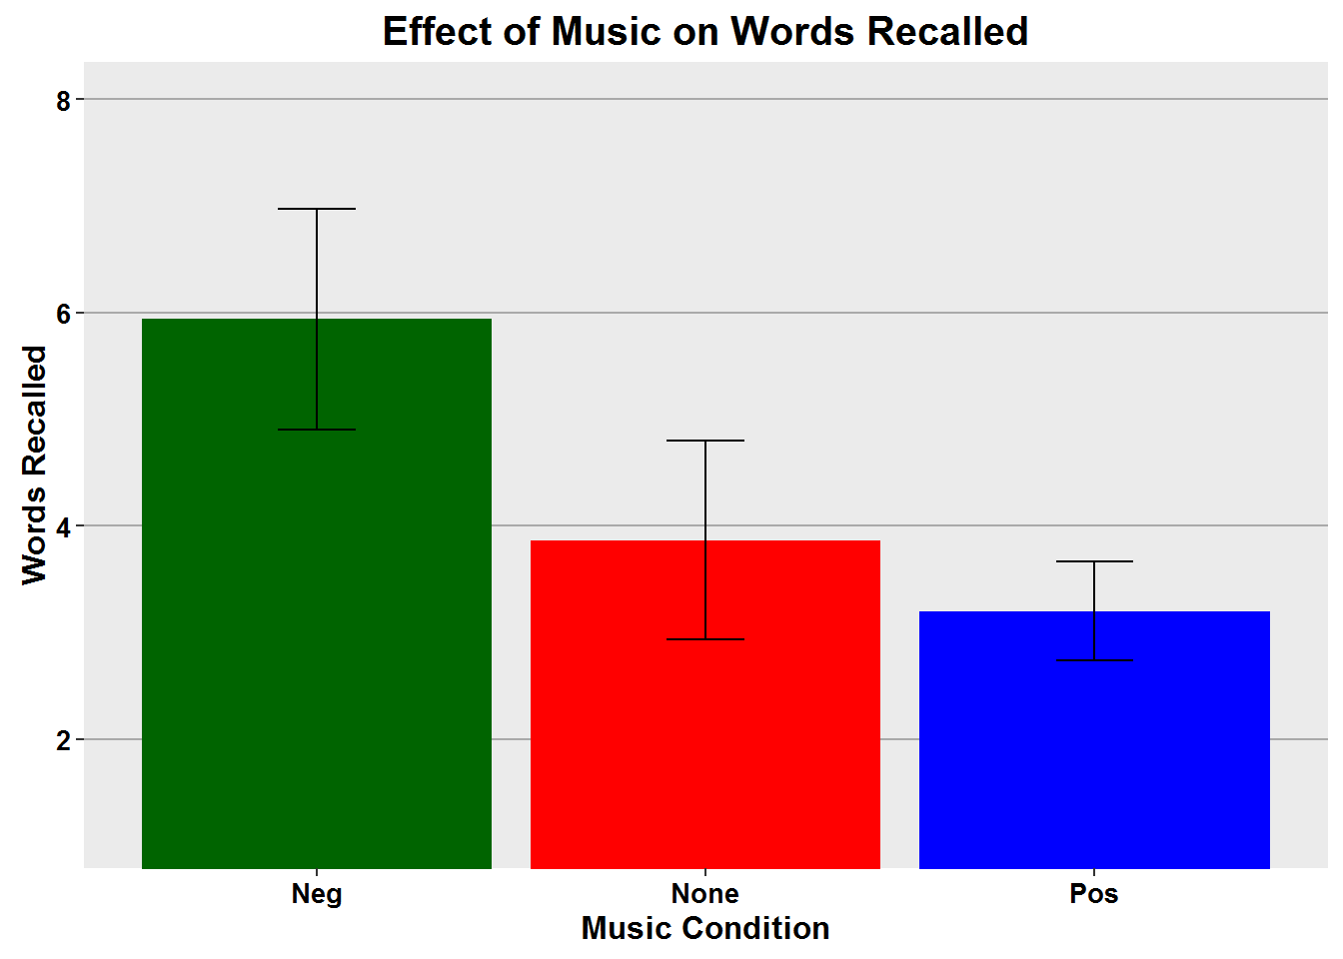
Effects of Music on Mood
Jessica M. Fagan-Sheehan and Tammy A. McCauley
Eastern Oregon University
Abstract
The purpose of this study was to:
Examine the link between music and mood
Determine if improved mood leads to better memory performance.
Hypothesis:
A positive mood created by positive music would result in the highest score on a memory task.
Introduction
Mood state at the time of encoding predicts better recall of mood congruent stimuli. (Palmiero et al., 2015; Salimpoor et al., 2011)
Mood altered by music may have
significant effects on:
Cognition and Learning
(Houston & Haddock, 2007)
Memory Performance
(Palmiero et al., 2015)
Arousal and Attention
(Balch et al., 1999; Palmiero et al.,
2015)
Increased Dopamine
(Salimpoor et al., 2011)
The stronger the evidence that positive music is helpful during learning, the greater the influence on choice of background noise during encoding and recall.
Music may lead to improved memory performance by:
Maintaining a person's level of arousal during encoding and recall. (Balch et al., 1999; Salimpoor et al., 2011)
Forming part of an environmental context in which stimuli are encoded and retrieved. (Palmiero et al., 2015)
To further investigate this environmental context and relationship of music on mood-dependent-memory tasks, we compared the effects of positive, negative, and no music on recall abilities.
Methods
Participants viewed a list of neutral words while listening to either no music (control group), or a minor key piece (negative), or a major key piece (positive).
Participants rated their mood state after exposure to the word list.
Participants completed a short mathematical distractor task.
Participants were asked to recall as many words as possible.
Results
The music condition had no effect on the participants mood rating, F(2,49) = 1.7, p = .187
The music did however have an effect on the number of words recalled correctly, F(2,49) = 3.2, p = <.05
The two tailed t-test indicated there was significant effect between the negative and positive conditions, t = 2.5, df = 35, p = 0.015.
Discussion
The significant difference in words recalled was between the negative and positive conditions. These results were opposite of what was hypothesized.
Mood as a function of the music condition, revealed no significant effect. Our research suggests that the negative condition had the best recall rates.
It was concluded that:
the music selections may have been interpreted differently than intended. The negative music may have been relaxing and the positive selection may have actually been too distracting during the encoding task
If so, it is likely that the negative music selection aided in concentration rather than producing a negative mood. For our experiment, the no music condition could have been less distracting than the positive music, allowing participants to encode more effectively. It is also possible that those in the no music condition could have been listening to something else of their choosing in the background while viewing the words.
One weakness of the study was that it was conducted via Facebook, an environment that is accessed heavily with cell phones, and the links to the YouTube music video clips did not work on cell phones, iPads, or with the Chrome browser.
Each computer (IP address) only used once.
Data from 29 of the 81 participants were excluded from the analyses for having incomplete data.
Previous research showed:
An effect of music on mood.
Performance indicated memory is enhanced by positive mood.
(Balch et al., 1999; Houston & Haddock, 2007; Palmiero et al., 2015)
Recommendations:
Conduct in a laboratory setting so the environment can be controlled.
Increase the sample size.
Use different music for the negative condition.
Summary
In this experiment:
Attempted to determine if there was an effect of positive music or negative music in a word recall task, with a control group who heard no music.
Data showed no significant effect of mood between the three music conditions.
The negative condition had the best recall of words.
The positive condition had the lowest recall.
References
Balch, W. R., Myers, D. M., & Papotto, C. (1999). Dimensions of mood in mood-dependent memory. Journal of Experimental Psychology: Learning, Memory, and Cognition, 25(1), 70-83. doi: 10.1037/0278-7393.25.1.70
Houston, D., & Haddock, G. (2007). On auditing auditory information: The influence of mood on memory for music. Psychology of Music, 35, 201-212. doi: 10.1177/0305735607070303
Palmiero, M., Nori, R., Rogolino, C., D’Amico, S., & Piccardi, L. (2015). Situated navigational working memory: The role of positive mood. Cognitive Processing, 16, 327-330. doi: 10.1007/s10339-015-0670-4
Salimpoor, V.N., Benovoy, M., Larcher, K., Dagher, A., & Zatorre, R.J. (2011). Anatomically distinct dopamine release during anticipating and experience of peak emotion to music. Nature Neuroscience, doi: 10.1038/nn.2726

